Slide 1
Germantown Middle School 7925 C.D. Smith Road Germantown, TN 38138
2024-2025
Annual Title I Meeting
tHursday, September 26, 2024
9:00 am AND 4:00 pm
Dr. Rhonda Anthony, Principal
Mr. Frederick Thorns, Assistant Principal
Mrs. Annette Lofton-Williams, Assistant Principal
Mr. Roba Zollicoffer, IB/Optional Coordinator
Ms. Ashley Miller, PLC Coach
Welcome!!! Please Sign In!!

Slide 2
Germantown Middle’s Vision and Mission

Slide 3
Education Law
The state of TN received a waiver from NCLB in February 2012. TN follows the Elementary and Secondary Education (ESSA) flexibility.
The Every Student Succeeds Act (ESSA) was signed by President Barack Obama on December 10, 2015, It reauthorizes the 50-year-old Elementary and Secondary Education Act (ESEA), the nation’s national education law and longstanding commitment to equal opportunity for all students.
ESSA gives the states more control to develop plans to improve educational outcomes for ALL students.

Slide 4
What is a Title I School?
Title I was passed in 1965 under the Elementary and Secondary Education Act (ESEA). It is the largest federal assistance program for our nation’s schools.
Title I schools receive extra funding (Title I dollars) from the federal government. These dollars are used to:
identify students experiencing academic difficulties and provide assistance to help these students;
purchase additional staff, programs, materials, and/or supplies; and
conduct parent and family engagement meetings, trainings, events, and/or activities.
ESSA Reform Blueprint
Great teachers and leaders in every school
Raising the bar and rewarding excellence
Creating college and career ready students
Providing equity and opportunity for ALL students
Promote innovation

Slide 5
3 Components of Title I/ESSA
Title I Funds
School wide
Professional
Development
Parental
Involvement

Slide 6
Title I, Part A: Basic Program Título I, Parte A: Programa Básico
Title I School-wide Programs
Provide resources to improve achievement as specified in School Improvement Plan
Programas en todas las escuelas de Título I.
Proveer recursos para mejorar los logros académicos como está especificado en los Planes de Mejoramiento Escolar.

Slide 7
10 Components of a Title I School-wide Program Componentes de un Programa Escolar de Título I
Needs assessment(Teachers, students, parents)
School-wide reform strategies that:
Increase the amount & quality of learning time (extended year, before- and after-school)
Address needs of all, but particularly low-achieving
Instruction by “highly qualified” teachers
Professional development
Strategies to attract high quality teachers
Parental involvement
Transition from pre- school and from middle to high school
Include teachers in assessment decisions
Timely, effective additional assistance
Coordination and integration of Federal, State and local programs
Necesita evaluación
Estrategias de reforma escolar que:
Aumentan el tiempo y calidad del tiempo de aprendizaje (año escolar extendido, programas antes y después de la escuela)
Dirigirse a las necesidades de todos, per especialmente a los que tienen un nivel bajo.
Instrucción por maestros “altamente calificados”
Desarrollo Profesional
Estategias para atraer a maestros altamente calificados.
Involucramiento de los Padres.
Transición de pre-escolar
Incluir a maestros en decisiones de evalucaión
Ayuda adicional efectiva y a tiempo
Coordinación e integración de los programas Federales, Estateles y locales

Slide 8
Family Engagement /Parental Involvement Contrato con la Familia Involucramiento de Padres
District level
School level
District Policy Política Distrital/Politica Escolar
Annual Meetings Reuniones Anuales
Open House
Parent/Teacher Conferences
Data Nights
School Policy
GMS Student Code of Conduct/Handbook
Annual Meetings
Title 1 Meetings
School Improvement Plan (SIP) Meetings
School-Parent Compact Pactos de Padres/Escuela
Family Engagement Plan Plan de Involucramiento de Familia

Slide 9
Professional Development
Leadership(In-town/Out of town PD, district level PD)
Educators(District level PD, contracted vendor PD, school level PD)
Parents/Families(school level PD)

Slide 10
Parents’ Right to Know El Derecho de Padres en Saber
All parents have the right to request the following:
A teacher’s professional qualifications, which includes state qualifications, licensure, grade/s certification, waivers
A teacher’s baccalaureate and /or graduate degree, fields of endorsement, previous teaching experience
A paraprofessional’s qualifications
An assurance that their child’s name, address, and telephone listing not be released to military recruiters
All parents will receive information on the following:
Their child’s level of achievement in each of the state academic assessments
Their option to request a transfer to another school within the district if their child is the victim of a violent crime at school
Their right to timely notification that their child has been assigned, or has been taught for four or more consecutive weeks by, a teacher who is not highly qualified
Todos los padres tienen derecho a solicitar lo siguiente:
Las calificaciones profesionales de un maestro, que incluye: Calificaciones del Estado, Licenciatura, graos de la certificación, Renuncia a derecho
El Bachillerato a Titulo de graduación del maestro, campos de especialidad, experiencia previa
La calificaciones del profesional
Garantía que los datos de su hijo como nombre, dirección, numero de teléfono, no se entregan a los reclutadores militares
Todos los padres recibirán información sobre lo siguiente:
El nivel de rendimiento de su hijo en cada una de las evaluaciones académicas del estado
Su opción de solicitar un traslado a otra escuela del distrito si su hijo/a es victima de un crimen violento en la escuela
Su derecho a aviso con tiempo anticipado que su hijo/a ha sido asignado o ha estado bajo la enseñanza durante cuatro semanas consecutivas o más, de un maestro que no está altamente cualificado

Slide 11
GMS Title I /ESSA Status GMS Titulo 1/ ESSA Status
GMS IS a Title I School
GMS is NOT a state identified Priority School
Teacher Qualifications
All teachers hold a state-issued teaching certificate or permit.
GMS STATE STATUS
Germantown MIDDLE SCHOOL IS A
Level 1
GMS
Goals for 2023-2024
Subject | Student Group | Projected AMO
ALL | ALL GRADE LEVELS | 37.7%
GMS es una escuela de titulo 1
GMS NO es un estado prioritario identificado Escuela
Todas los maestros tienen un certificado o permiso de enseñanza permiso por el estado.

Slide 12
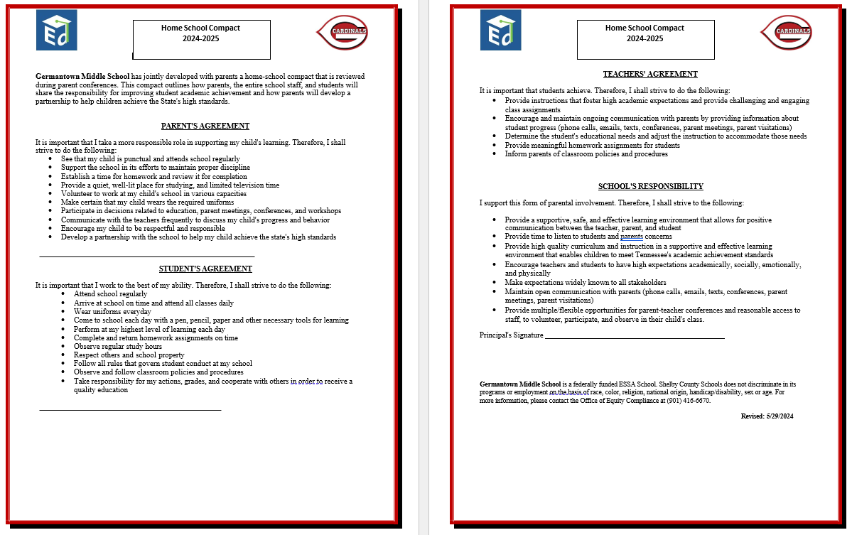
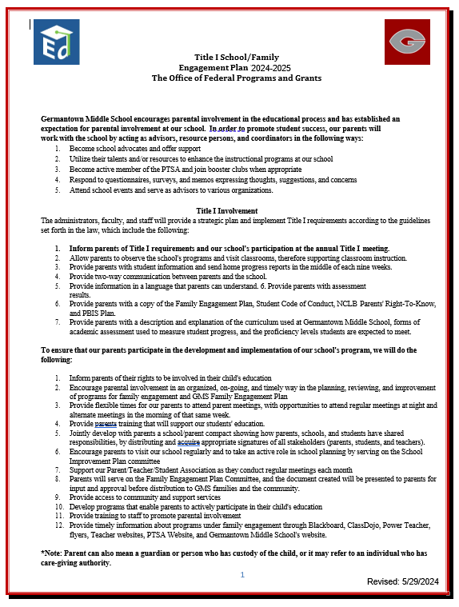
2024-2025
Home-School Compact
2024-2025
Family engagement plan

Slide 13
Additional Family Engagement opportunities/ Trainings
Literacy and Math Night
CCTE/STEM Night
TN Ready Gear Up Night
Calculator Training

Slide 14
Parent Communication/Reporting Student Progress Parent Communication/Reporting Student Progress
Updates On:
School Website
Phone Calls
Flyers
School Messenger
School DOJO
Mid Term Progress Reports
Quarter 1- September 4, 2024
Report Cards
Quarter 1- October 23, 2024
Parent/Teacher Conferences
District Wide:
September 5, 2024, 4-7PM
February 13, 2025, 4-7PM
Reportes de Progreso semanales
Reportes de Progreso (La tercera semana de cada periodo)
Conferencias de Padres-Maestros
En todo el distrito:
Septiembre 7 ~ 4-7pm
https://www.classdojo.com/ul/p/addKid?target=school&schoolID=53e71e8b306d73bd29003324

Slide 15
gms Curriculum & instruction
ELA
MATH
Ready Classroom(Math)
SCIENCE
MyPerspectives (ELA)
SOCIAL STUDIES
5 E’s- Engage, Explore, Explain, Elaborate, Evaluate
Gradual Release of Responsibility
Gradual Release of Responsibility
Try IT, Discuss IT, Connect IT
HHM Tennessee Science/Physical Science
McGraw Hill World History and Geography: Ancient Civilizations

Slide 16
GMS Annual Assessments
I Ready Benchmark Assessments
In House Cardinal Common Assessments
District Common Formative Assessments
TN Ready/TCAP Testing
Fall, Winter, Spring
Bi-Weekly
Fall, Winter, Spring
April of 2024

Slide 17
Germantown MIDDLE SCHOOL NEEDS YOU!!!

Slide 18
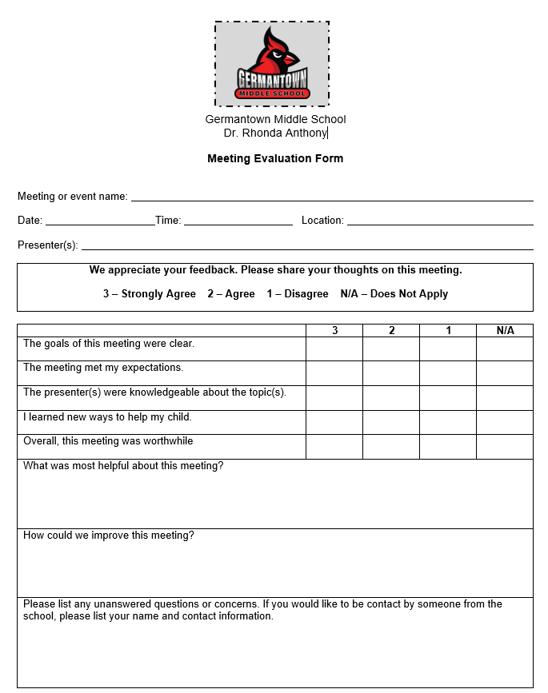
Please complete the Evaluation form
“Cardinals of the same feather flock together.”

